Slide 1
Esat Ertuğrul Filiz 161805058 Erdem Kuru 181805066 Bartu Duman 181805056 Hasan Kaplan 161805052
DIMENSION runner

Slide 2
Our project targets users in the entertainment field. It is to relieve and enjoy the users who are under the stress of daily work and life.

Slide 3
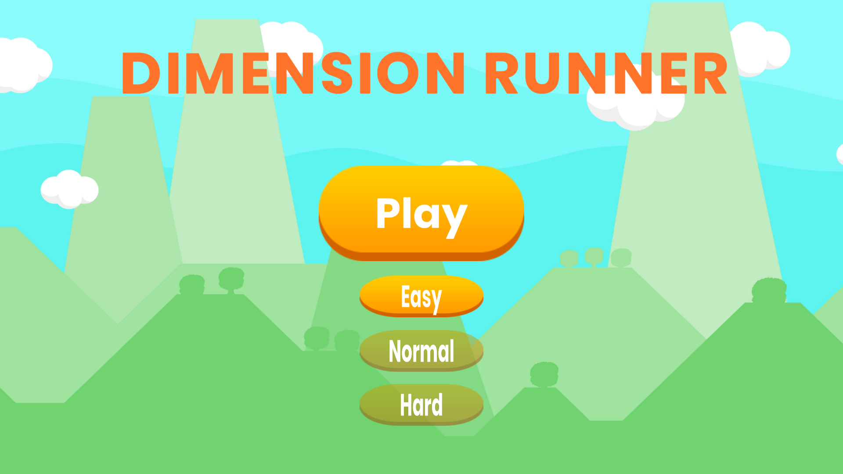

Slide 4
With our hero advancing in an endless loop in our game, higher points are obtained by overcoming obstacles
Besides, to be more successful in the game, we can increase our score as we get rid of the traps and collect the gold and lives that come before us.

Slide 5
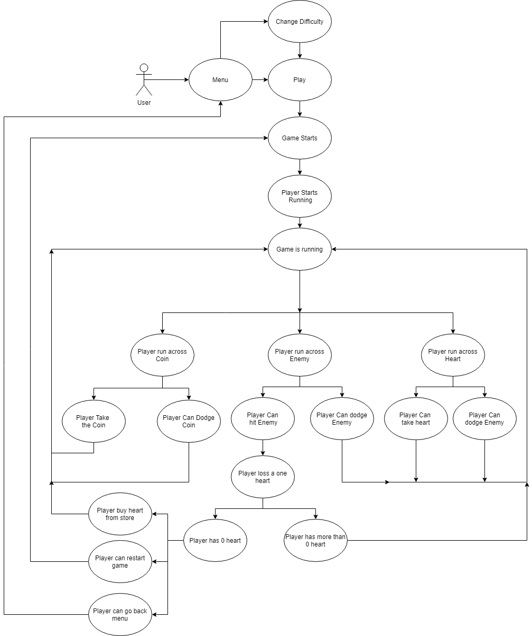

Slide 6
As the points increase and the gold accumulated in the game, we add different visuals to our character and bring the fun to different dimensions.
However, with the store that we will add to our game in the future, different products that we cannot obtain in the game will be available from the market.

Slide 7
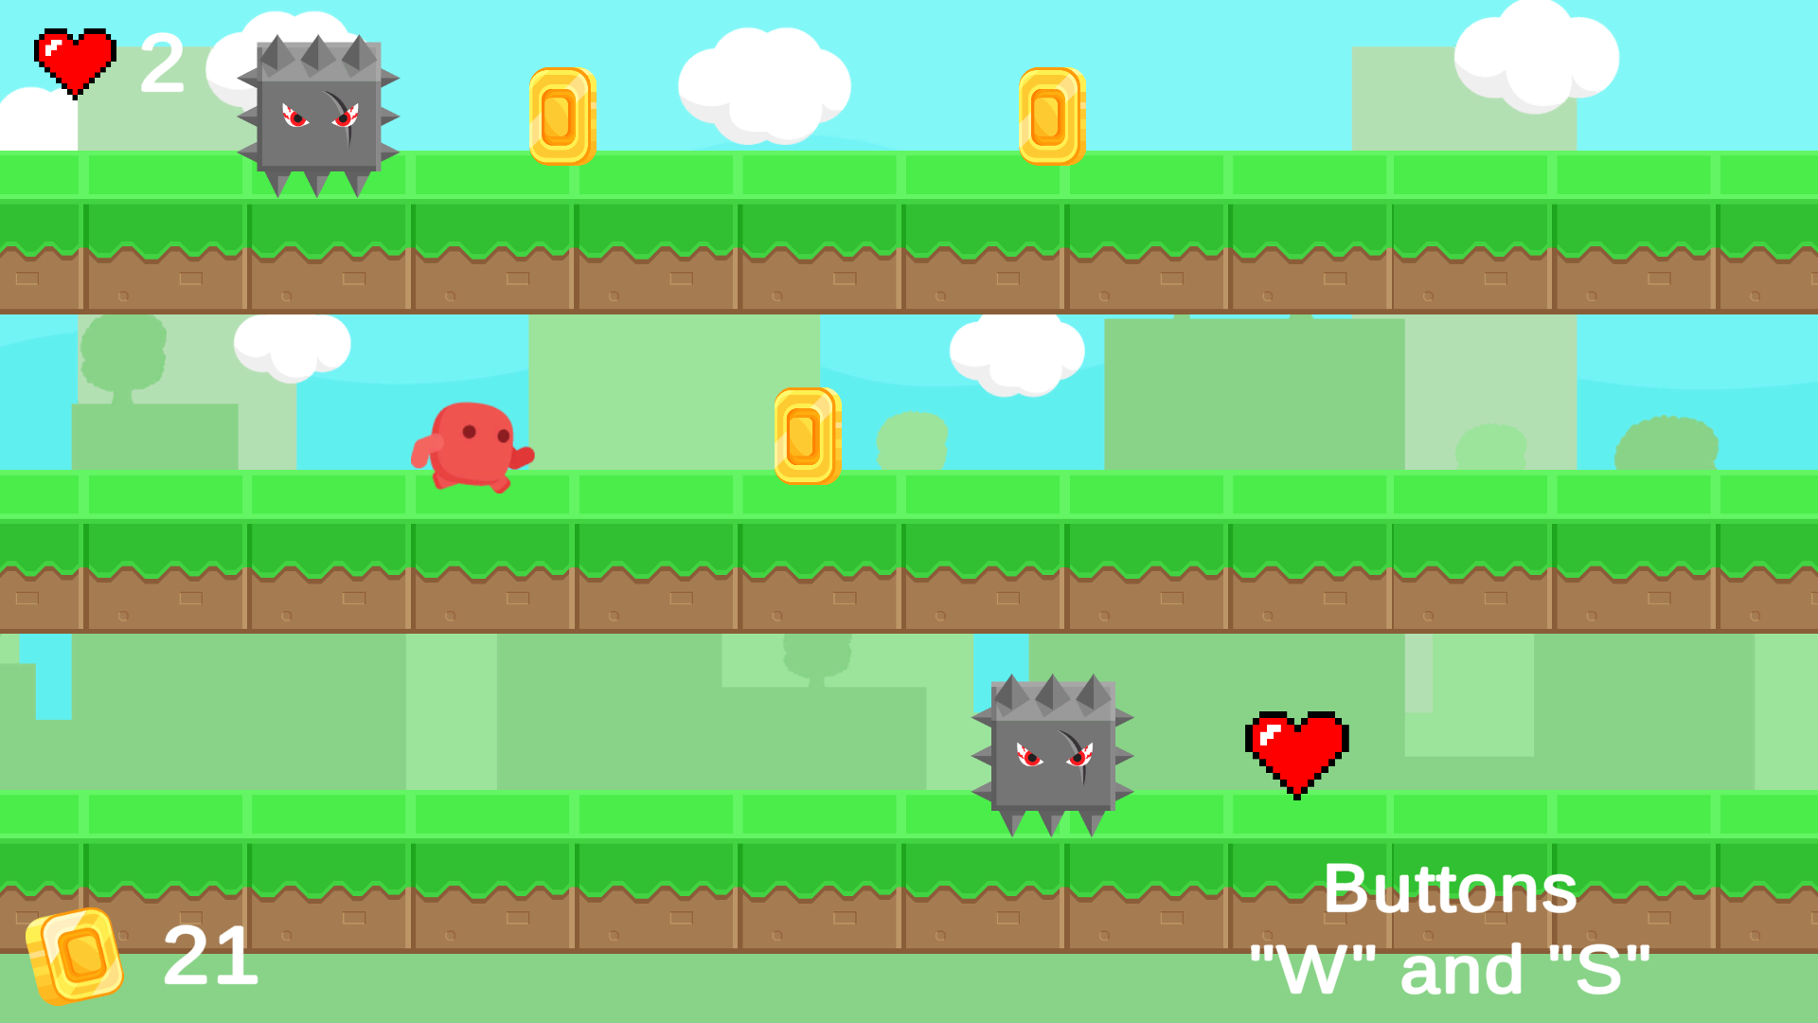

Slide 8
With the update that will come to our game in the future, the mail system and technical support will be provided.
It will be added at different levels such as easy, medium, and hard

Slide 9
As a result, we have gained a nice experience by having fun and gaining new information while preparing our project .
Because we have fun and try to make people happy in our game that we prepared to relieve people under stress nowadays.
To sum up, we learned to work as a team harmoniously.

Slide 10
Thanks for your attention

